Slide 1

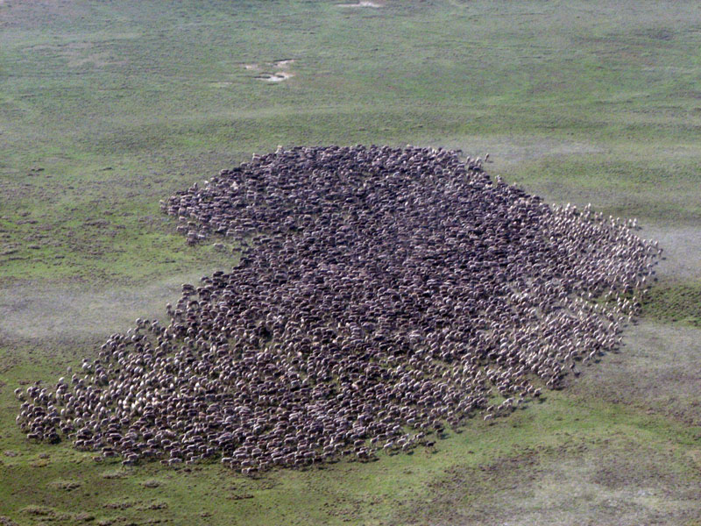
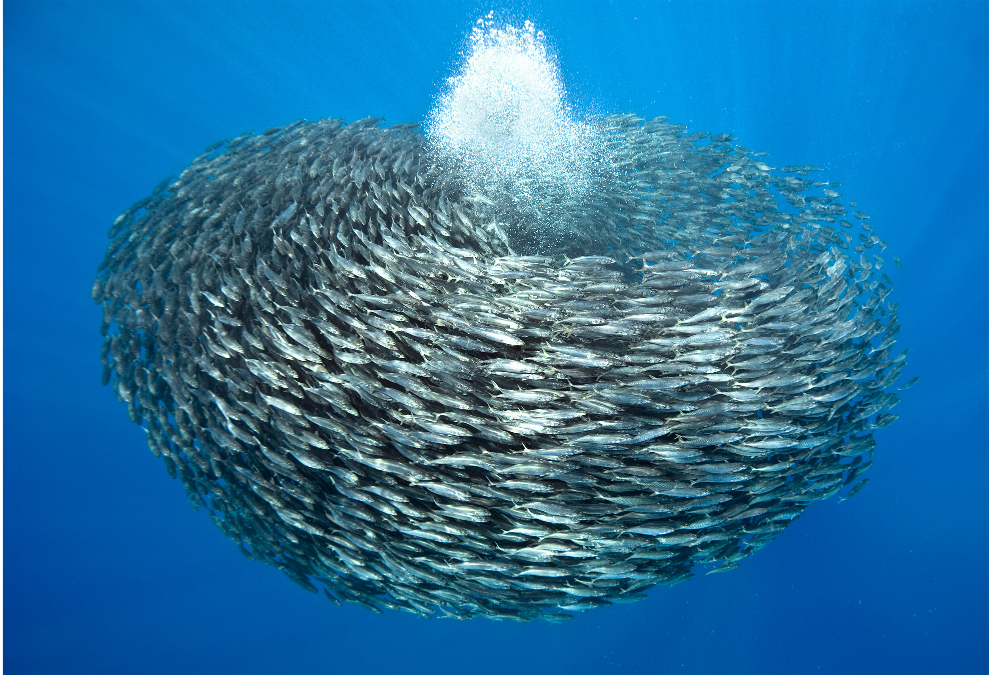
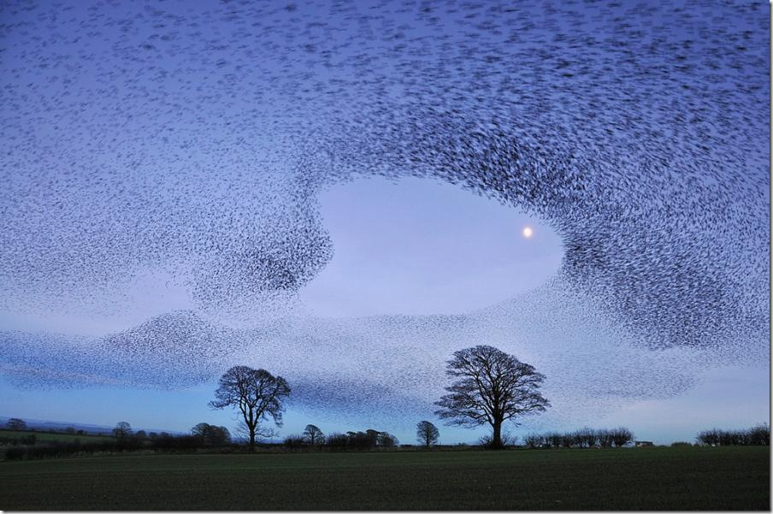
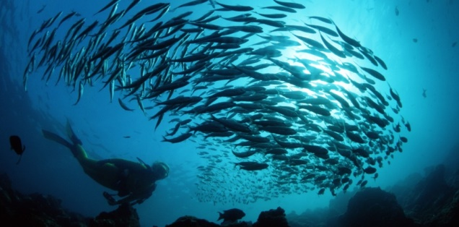
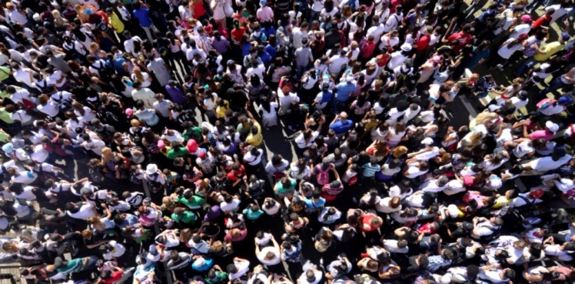
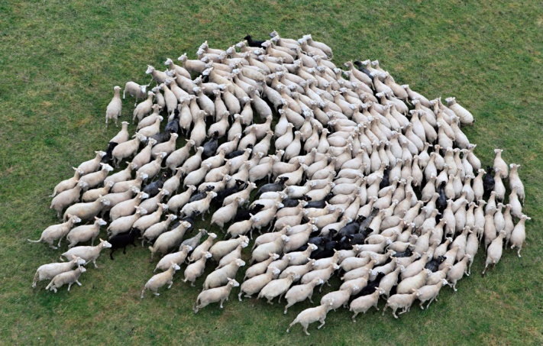
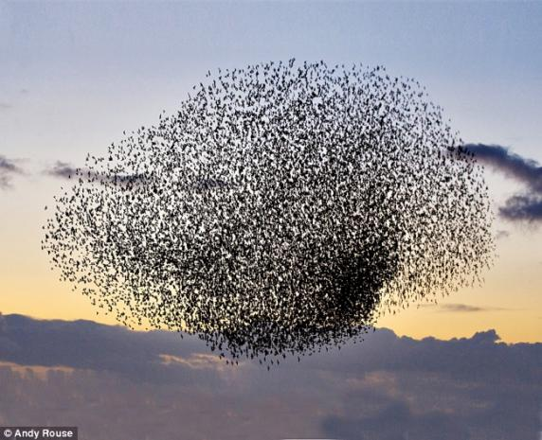
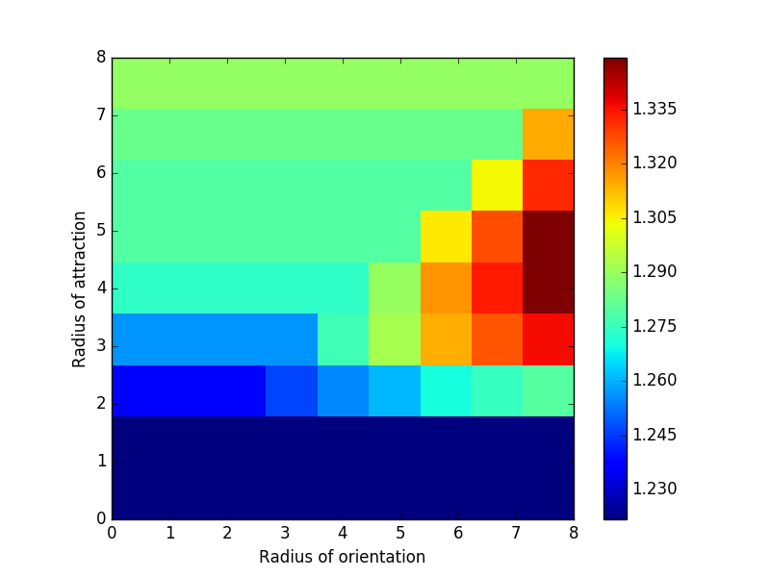
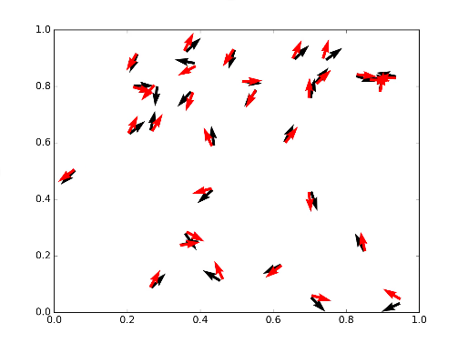
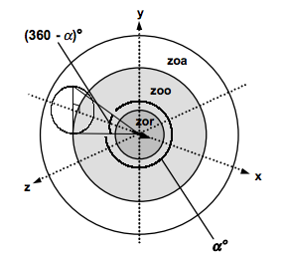
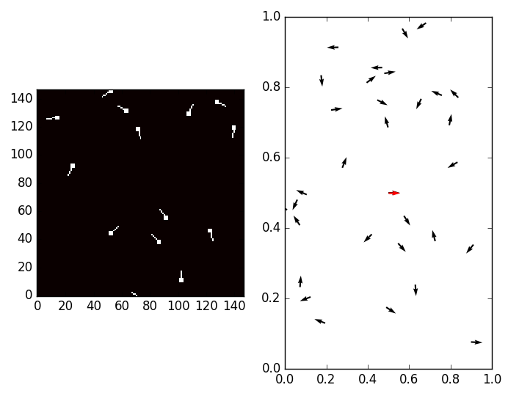
Collective Behavior: Using simulatuions and machine lEARNING
Nicole Wang, Professor James Puckett
Department of Physics, Gettysburg College, Gettysburg, PA
Introduction:
Collective animal behavior is observed very frequently in nature in many different groups of organisms. It exists throughout the animal kingdom, from fish schools, bird flocks, and bee swarms to traffic and social networks.
If we can model these systems, then we can predict them. But we first need to figure out how individuals interact but this is a challenging problem.
Compare with Experimental Data:
Fish Tractories from Neural Network and Couzin Model:
How well does the Couzin model fit experimental data?
We compute the average error of the predicted motion using the Couzin model with experimental data.
Error is huge (around 1.23 ~1.34 radian)
Red Arrow: fish tractories from Neural Network model
Black Arrow: fish tractories from Couzin model
Observe trajectories diverge but very slowly
Couzin Model:
A model of simplified interactions:
Interactions based on position and velocity of neighboring individuals:
Repulsion
Orientation,
Attraction.
Generates morphologies seen in nature: swarms, flocks, and mills.
Our Approach:
Leverage neural networks to “learn” the model of the the behavior.
Testing our approach:
Make trajectories from Couzin simulation (known interactions)
See if our neural network model can learn it
Apply the technique to our experiment (can it learn behavior of real fish?)
Figure 2: Fish tractories comparasion between Couzin Model and Neural Network
Conclusion:
Couzin model does not reproduce real fish group behavior
Neural Network is able to learn and build a model by giving data ➔ Neural Network Promising
Figure 1: Couzin Model
Neural Network:
Future Work:
Apply Neural Network model to our experiment data
Collect more experimental data to improve Neural Network Model
An algorithm of machine learning system (lots of linear algebra)
A biologically-inspired programming that enables a computer to learn from observational data.
Reference:
Fish Image: raw data input to Neural Network
Nielsen, Michael A. “Neural Networks and Deep Learning.” Neural Networks and Deep Learning, Determination Press, 1 Jan. 1970, neuralnetworksanddeeplearning.com/chap1.html.
Arpathy, K. “Convolutional Neural Networks.” CS231n Convolutional Neural Networks for Visual Recognition, Github, cs231n.github.io/convolutional-networks/.
Comparing models:
How can we measure how good a model is at predicting individual trajectories?
Error θ, is the angle between the predicted trajectory as and model/experimental trajectory.
Average of individuals and time.
Experiment
time t + Δt
θ
Predicted
time t + Δt
Acknowledgement:
Weight: adjust during training in order to improve accuracy of output
Direction: how the fish turns on next move
Gettysburg College (X-SIG)
Dickson Fund (X-SIG Fellow)
Individual at time t

